Slide 1


COST OF LIVING ANALYSIS WITH POWER BI
BY RAJI ABDULSAMAD
WELCOME TO THE DASHBOARD ANALYSIS

Slide 2

COST OF LIVING ANALYSIS WITH POWER BI
INTRODUCTION
The primary purpose of this presentation is to demonstrate the process of creating and analyzing a Power BI dashboard for cost of living data. This involves showcasing the end-to-end workflow, from data acquisition and cleaning to developing an interactive dashboard that provides valuable insights into living costs across different cities, countries and continents/region.

Slide 3
COST OF LIVING ANALYSIS WITH POWER BI
OBJECTIVES
Understand the Dataset
Using The ETL process
Data Cleaning and Preparation
Dashboard Development
Using the DAX function
Analysis and Insights

Slide 4
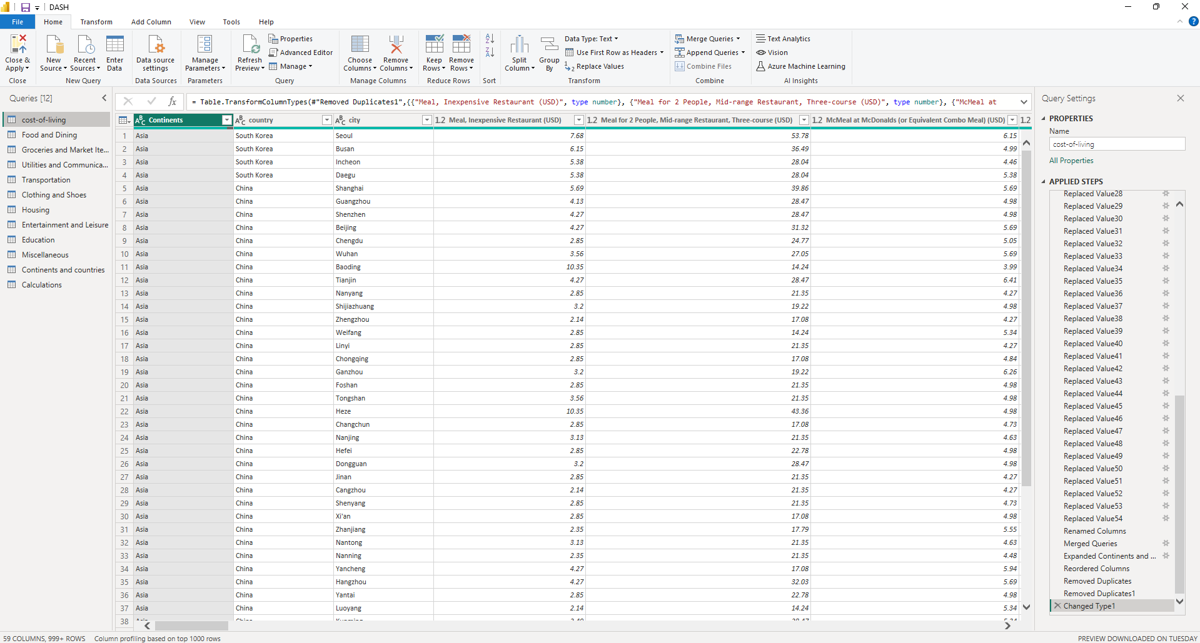
POWER QUERY

Slide 5
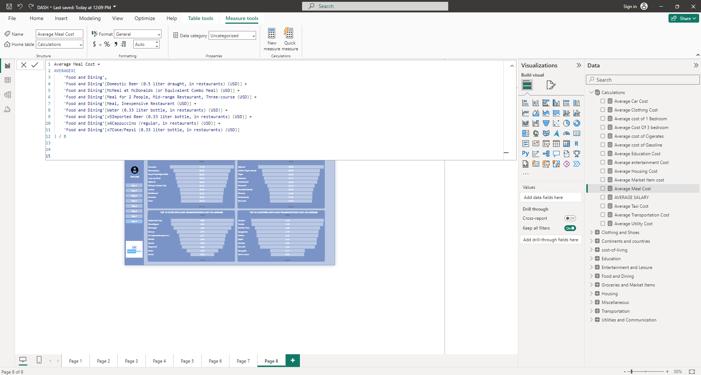
USING DAX FUNCTIONS TO CALCULATE THE AVERAGE

Slide 6
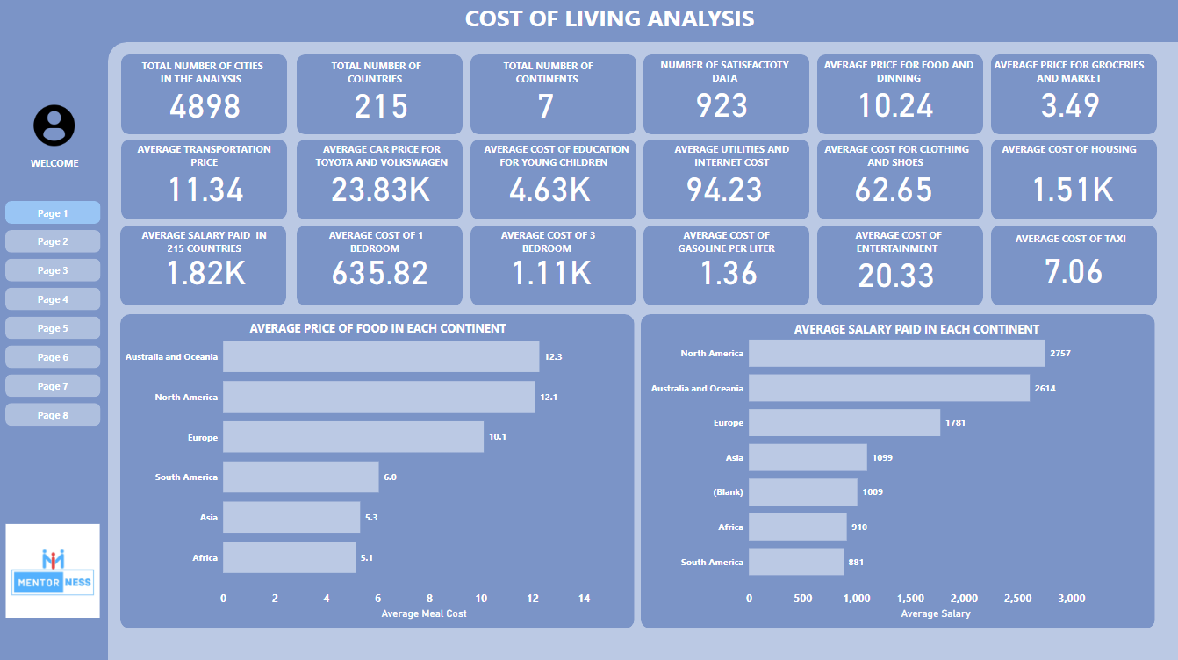

Slide 7
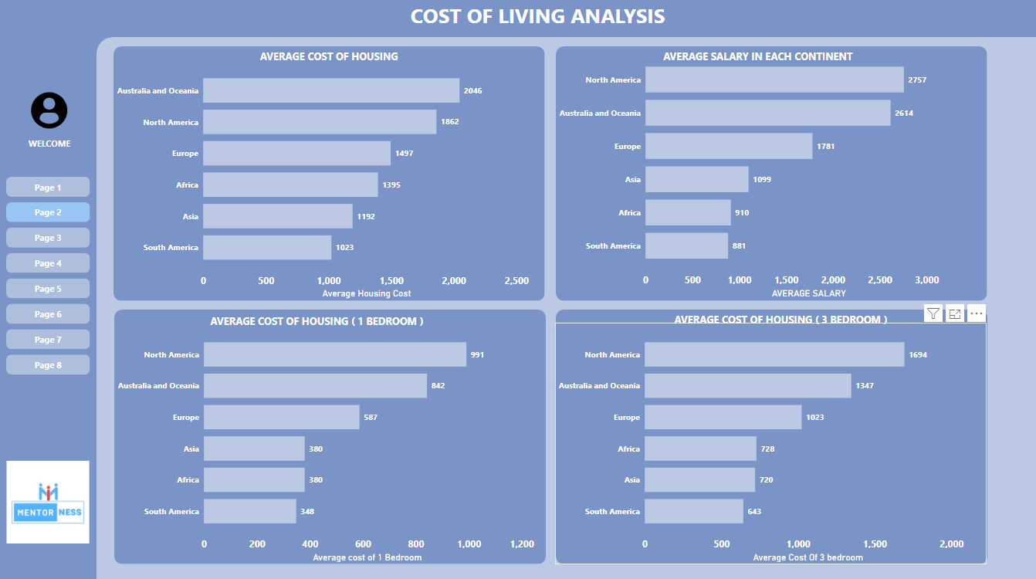

Slide 8
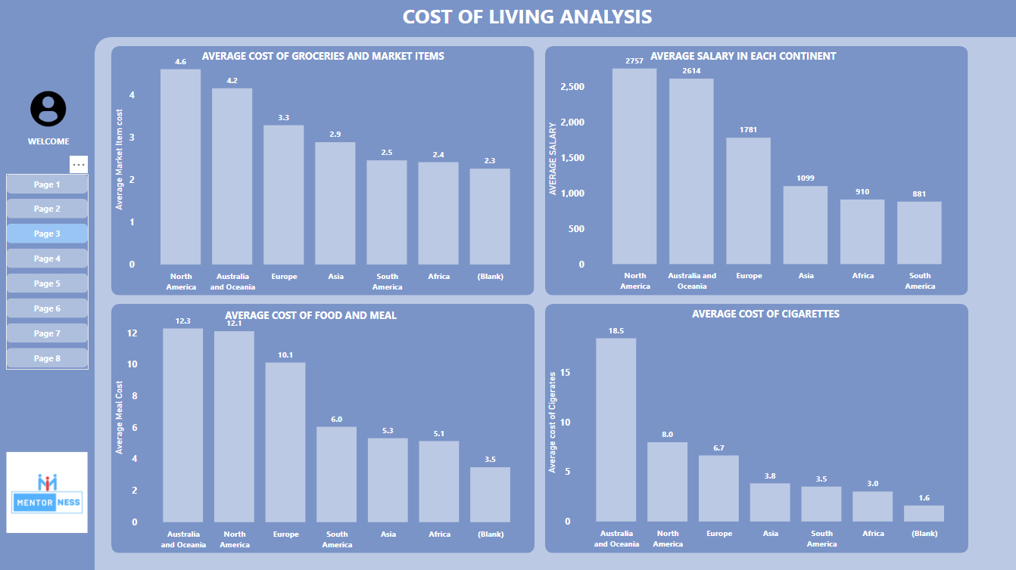

Slide 9
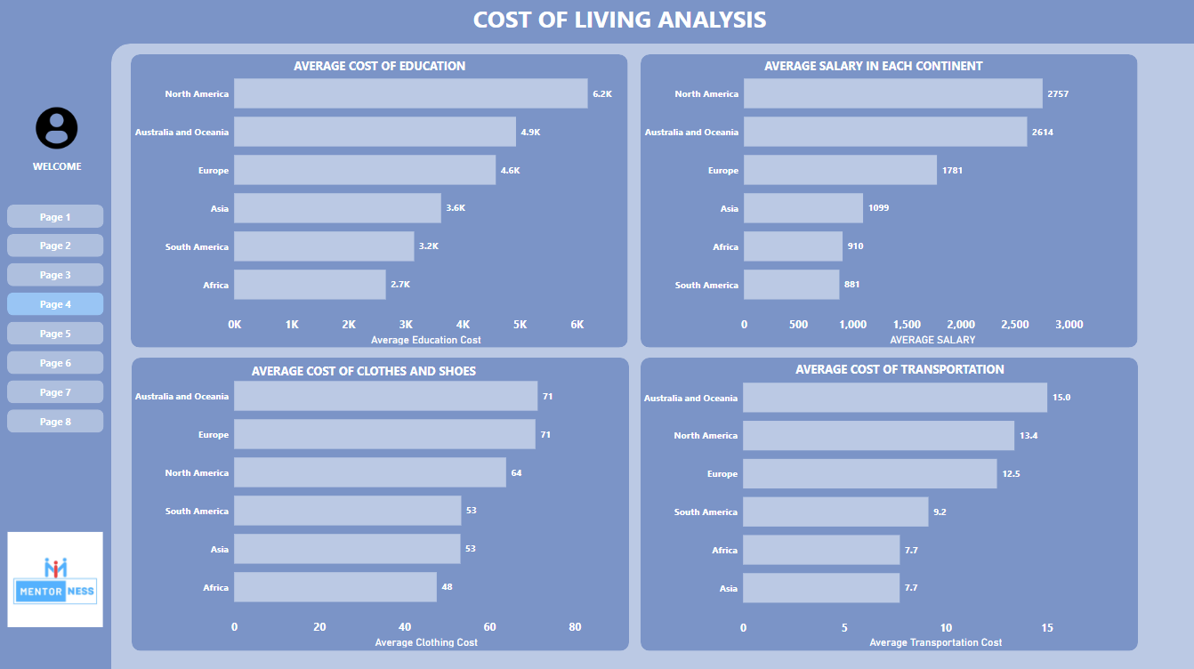

Slide 10
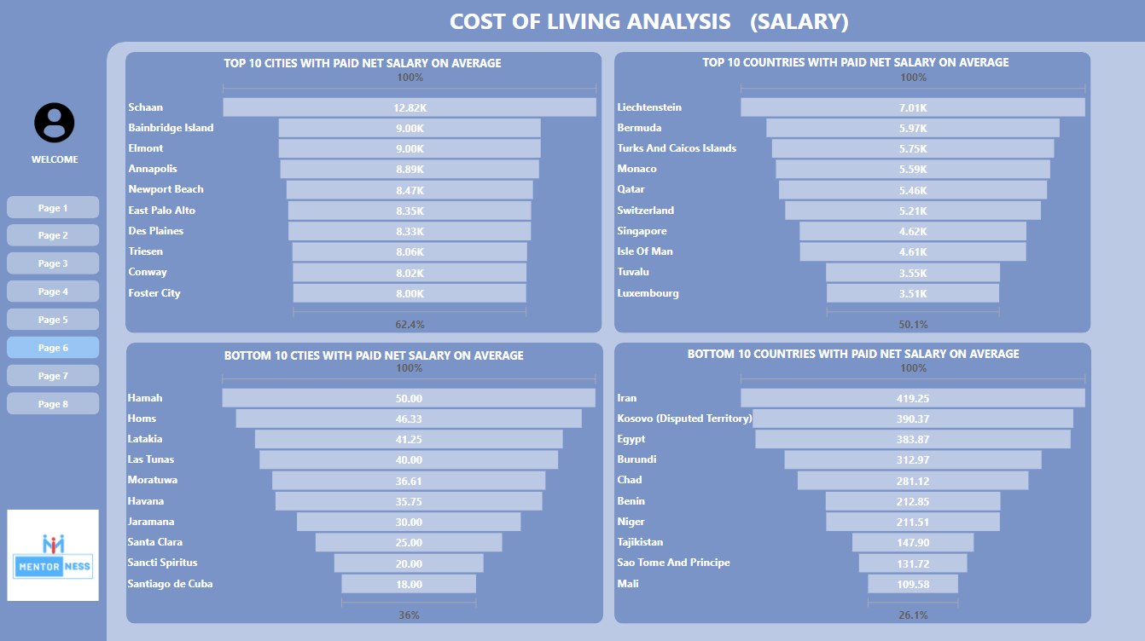

Slide 11
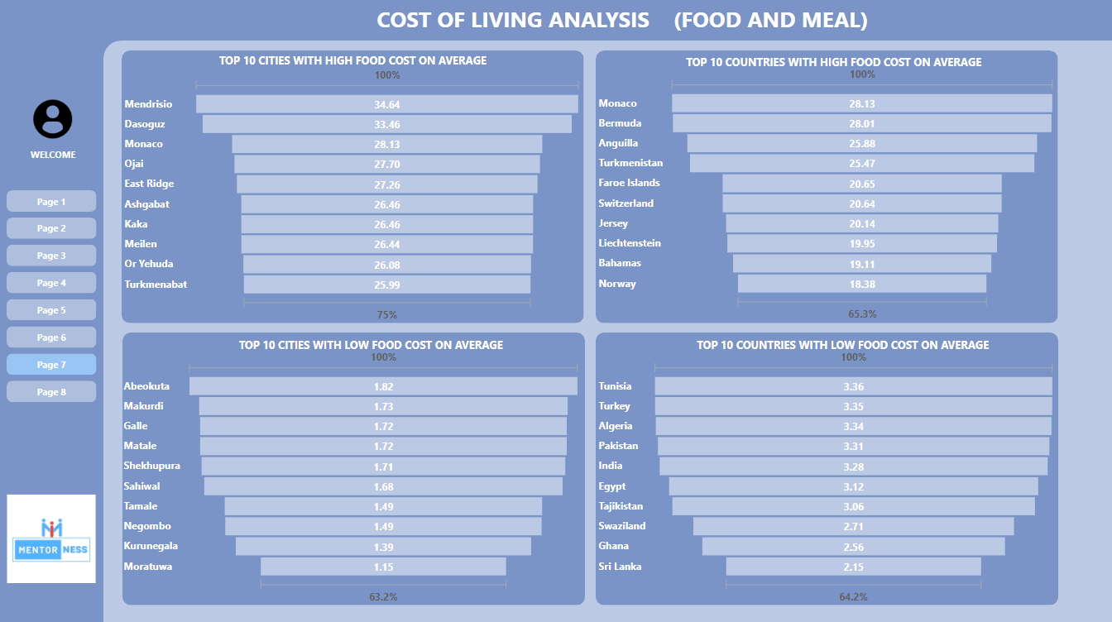

Slide 12
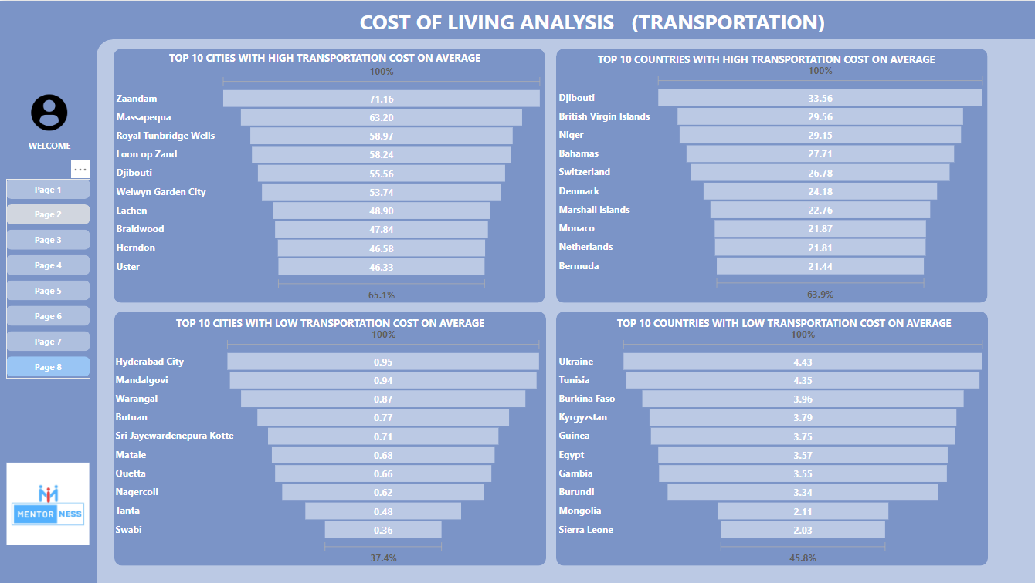

Slide 13
COST OF LIVING ANALYSIS WITH POWER BI
THANK YOU

